Slide 1
Parallel Processing Priority Trie-based IP Lookup Approach
Author: Hootan Zhian, Muhammad Bayat, Maryam Amiri, Masoud Sabaei
Symposium : Telecommunications (IST), 2014 7th International Symposium on
Presenter: Yen-Chun Tseng
Date: 2015/10/21
Department of Computer Science and Information Engineering
National Cheng Kung University, Taiwan R.O.C.
Notes:
1

Slide 2
Introduction
A new approach that was constructed by combining Priority trie and parallel processing.
A method consists of a trie and several subtries based on prefix length.
These subtries processed by a specific thread to speed up.

Slide 3
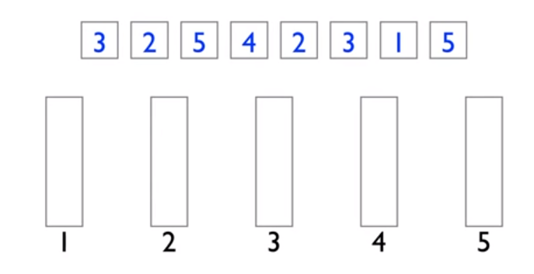
Proposed scheme (related work)
Bucket sort

Slide 4
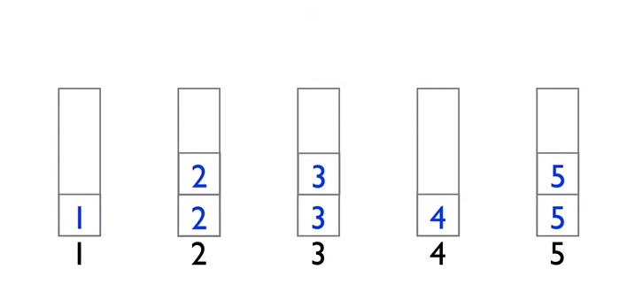
Proposed scheme (related work)
Bucket sort

Slide 5
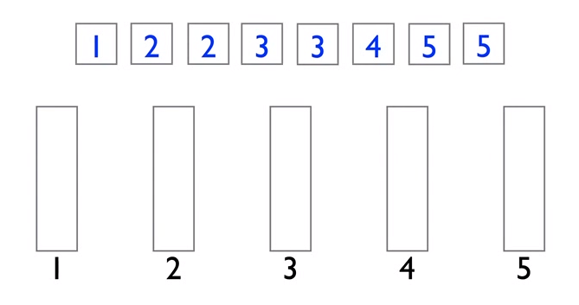
Proposed scheme (related work)
Bucket sort

Slide 6
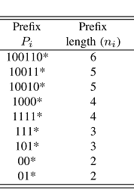
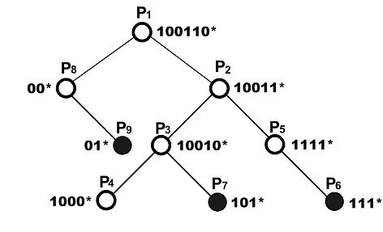
Proposed scheme (related work)
Priority trie

Slide 7
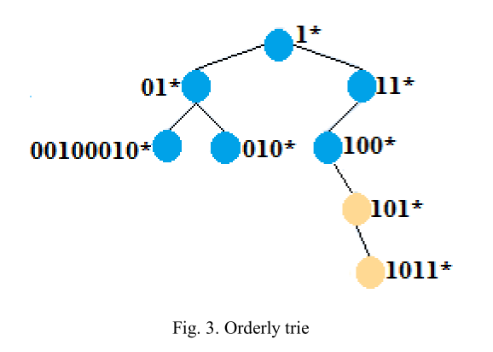
Proposed scheme
ID | Prefix
0 | 1*
1 | 01*
2 | 11*
3 | 010*
4 | 100*
5 | 101*
6 | 1011*
7 | 00100010*

Slide 8
Proposed scheme (lookup)
Based on the IP address bit pattern, we move down on the trie until we reach an ordinary node. Since the prefixes are stored based on their length, all prefixes before this ordinary one have shorter length.
We continue moving down from this ordinary node and compare the address with the prefixes in each node. If the address matches with a prefix, equivalent port is selected as an output port. This process continues until it reaches a leaf.

Slide 9
Proposed scheme
First the node is deleted. If it had two children, the one with shorter length is replaces the deleted node.
If the deleted node had only one child, its child should replace it.

Slide 10
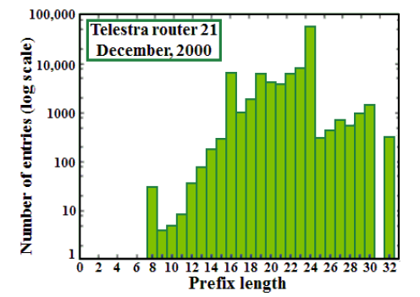
Proposed scheme

Slide 11
Proposed scheme
8 level Priority trie :
  A Priority trie with the maximum of eight levels to store 24 to 32-bit prefixes.
Priority subtries :
  A set of Priority subtrie from level 8.
  The remaining 24 to 32-bits prefixes stored in these subtries.
  The subtrie ID first 8 bits of the prefixes.
Orderly subtries :
  A set of Orderly subtries that are defined from level 8.
  Prefixes with 8 to 24 are stored in these subtries.
  The subtrie ID is based on the first 8bits of the prefixes.

Slide 12
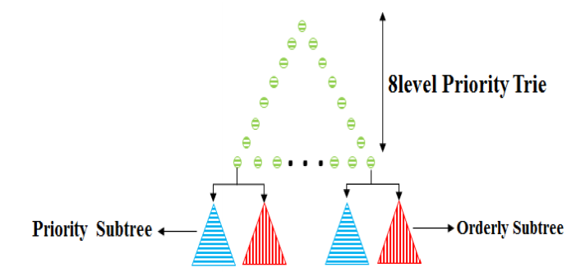
Proposed scheme

Slide 13
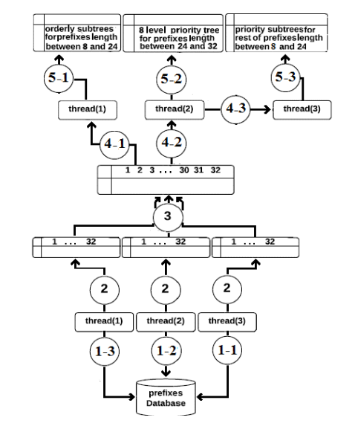
Proposed scheme

Slide 14
Proposed scheme
Search :
Thread (1) in Orderly subtries.
Thread (2) in Priority trie.
Thread (3) in Priority subtries.
Thread (1) and thread (3) select the appropriate subtries based on the most significant 8 bits. They lookup these subtries by algorithms used in Priority and Orderly tries.
Output port is selected based on the result that is given by a thread and longest prefix match.

Slide 15
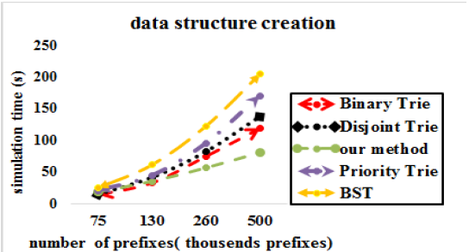
Experimental Evaluation

Slide 16
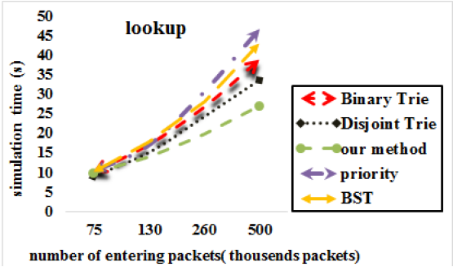
Experimental Evaluation

Slide 17
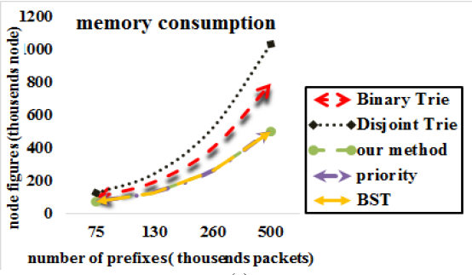
Experimental Evaluation

